Slide 1
Data Analysis and Dashboard creation Data used:https://www.kaggle.com/datasets/taweilo/mba-admission-dataset
Date of submission: 2024 Sep 25
Jithinlal M M
Registration Number: 1631
Department: Business Analytics
Mentor: Navya Nair
BDE: Geethu S
Joining Date: 3rd July 2024

Slide 2
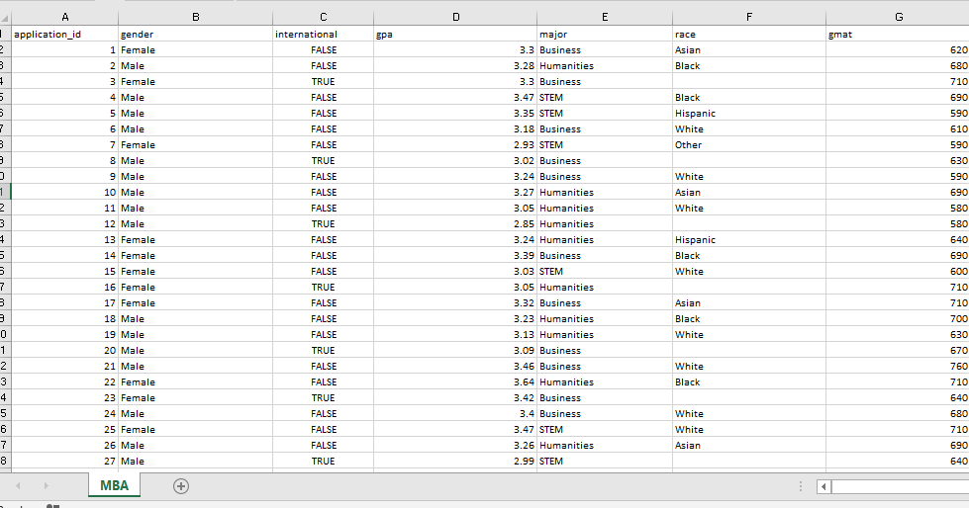
General View before cleaning

Slide 3
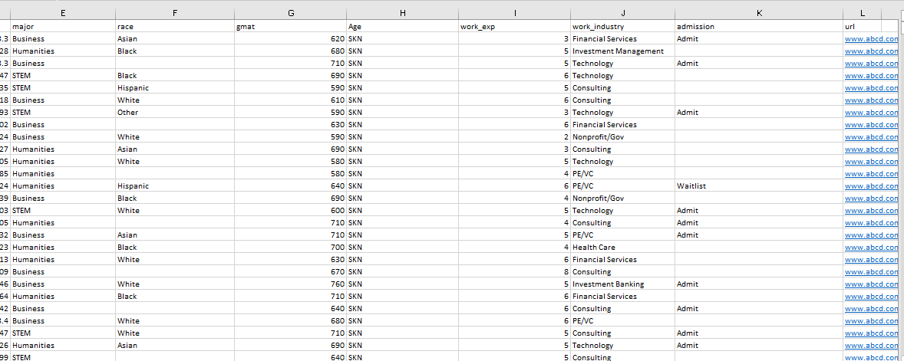
General View 2
General View before cleaning

Slide 4
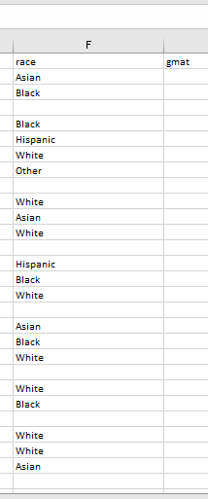
Data need to be filled in Race column

Slide 5
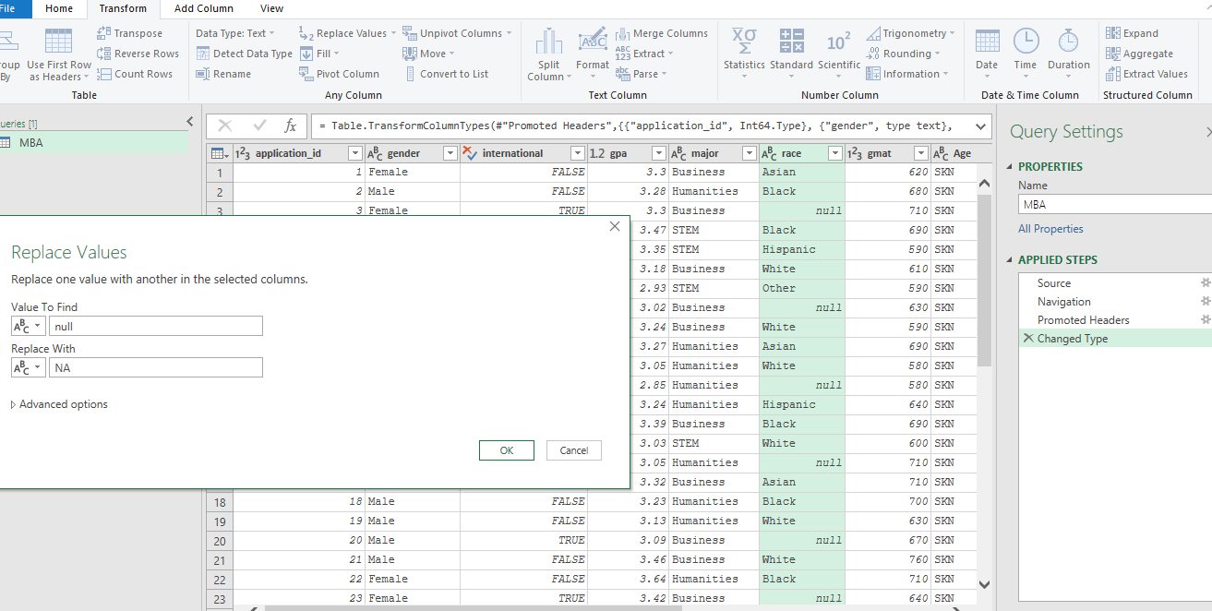
Data missing correction

Slide 6
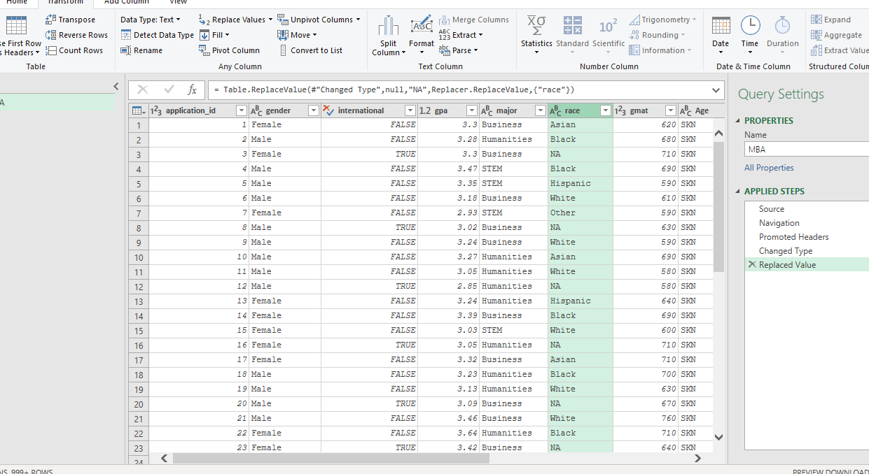

Slide 7
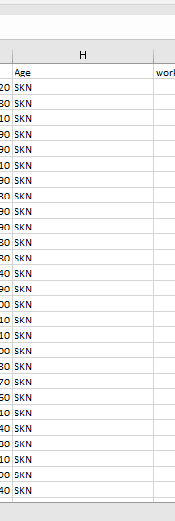
Age column need to be removed

Slide 8
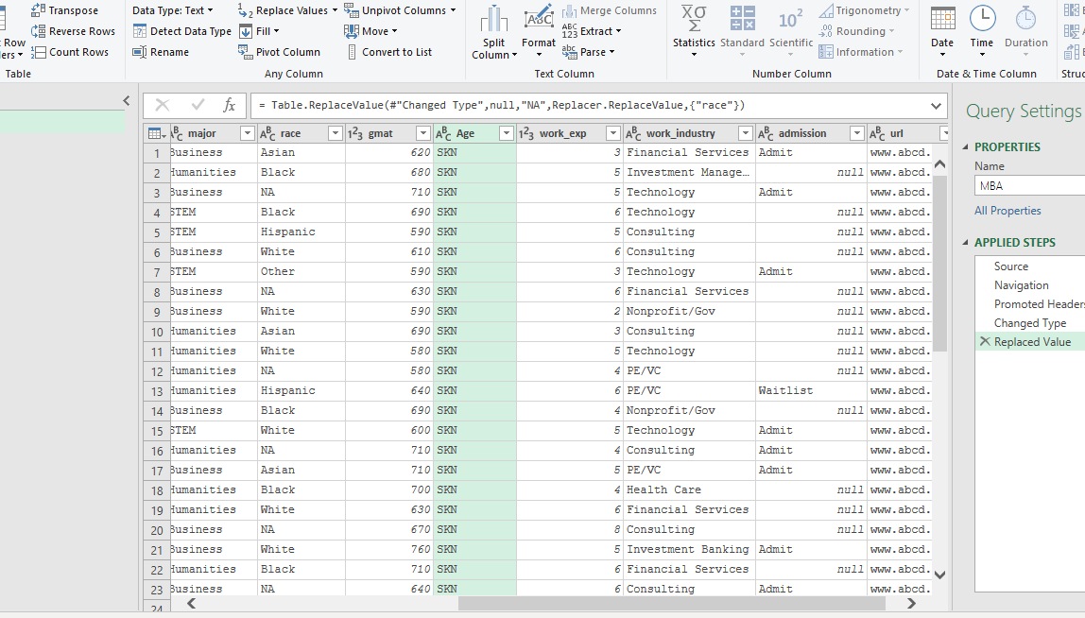
Age data removal

Slide 9
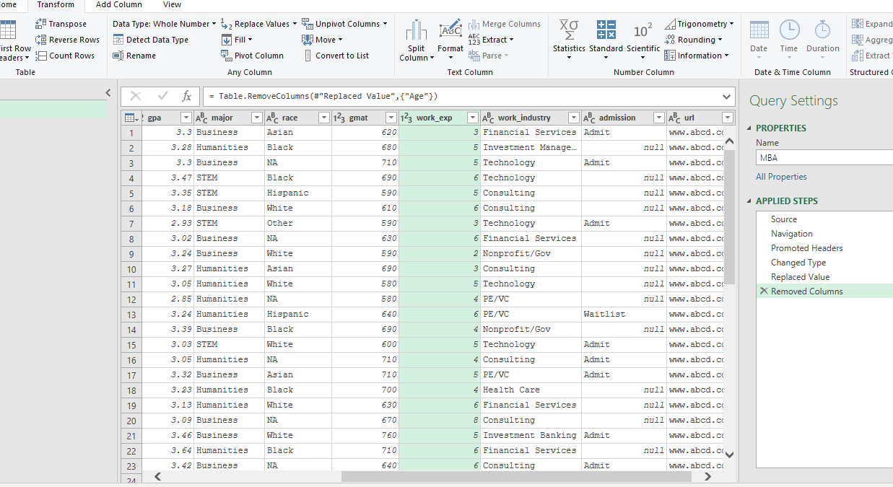

Slide 10
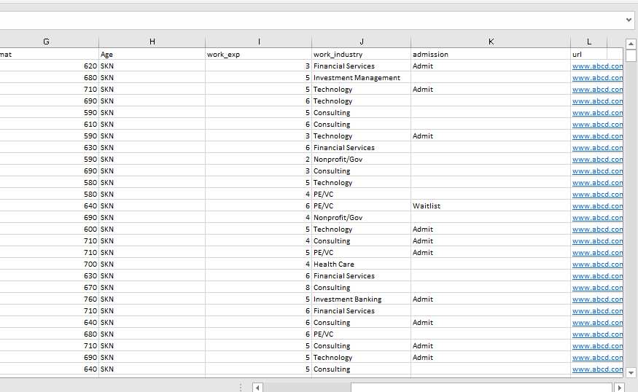
Url column need to be removed

Slide 12
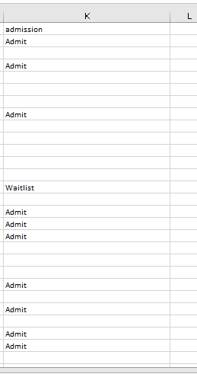
Data need to be filled in Admission status column

Slide 13
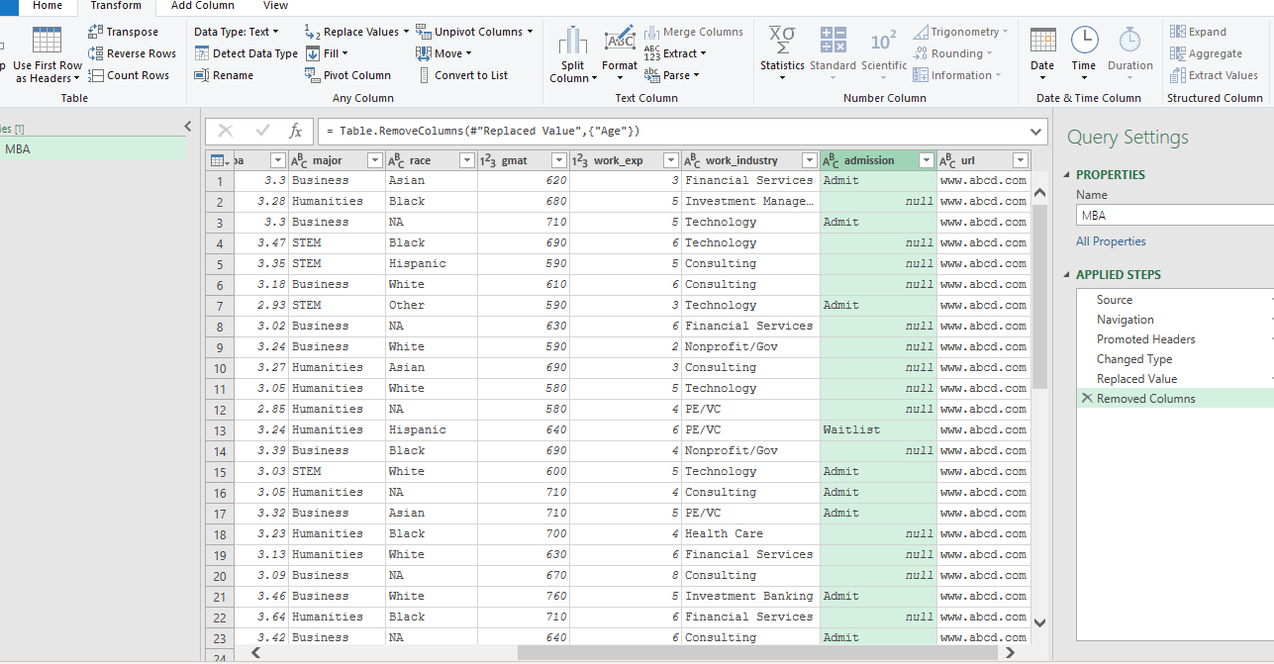

Slide 14
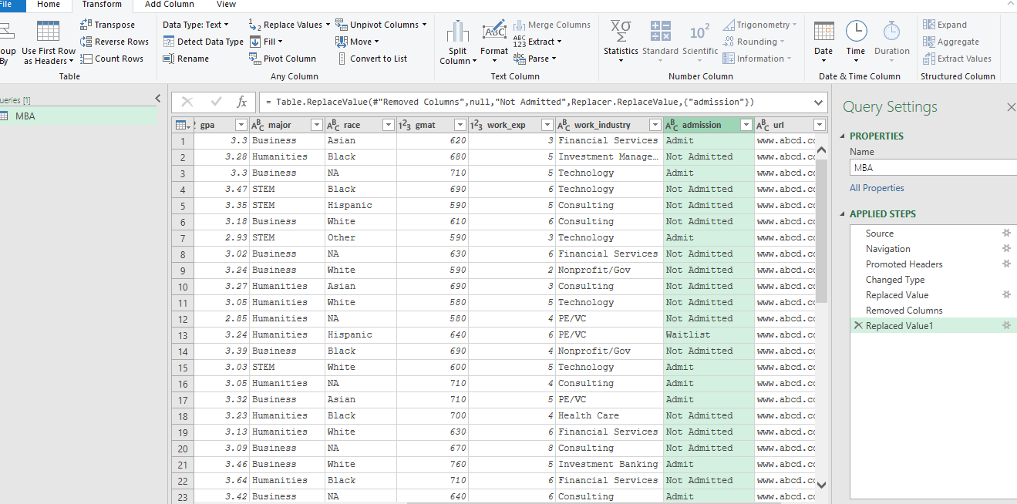

Slide 15
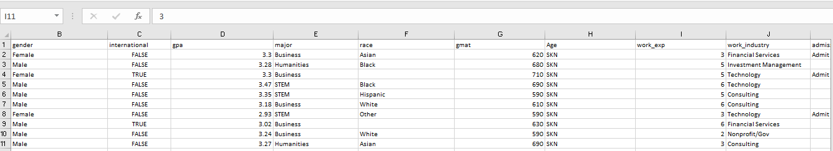
First row need to be converted as header

Slide 16
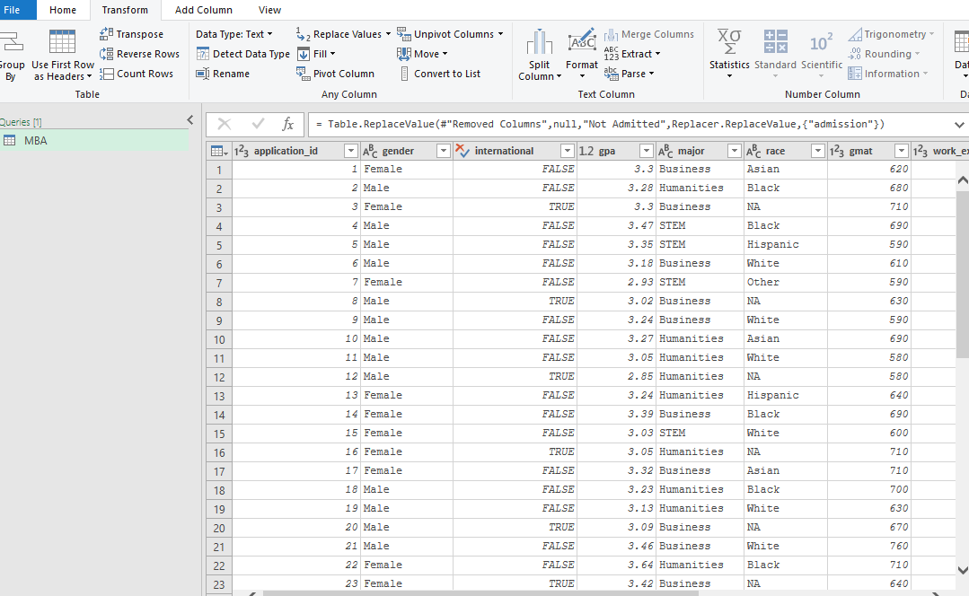
Heading good in pq

Slide 17
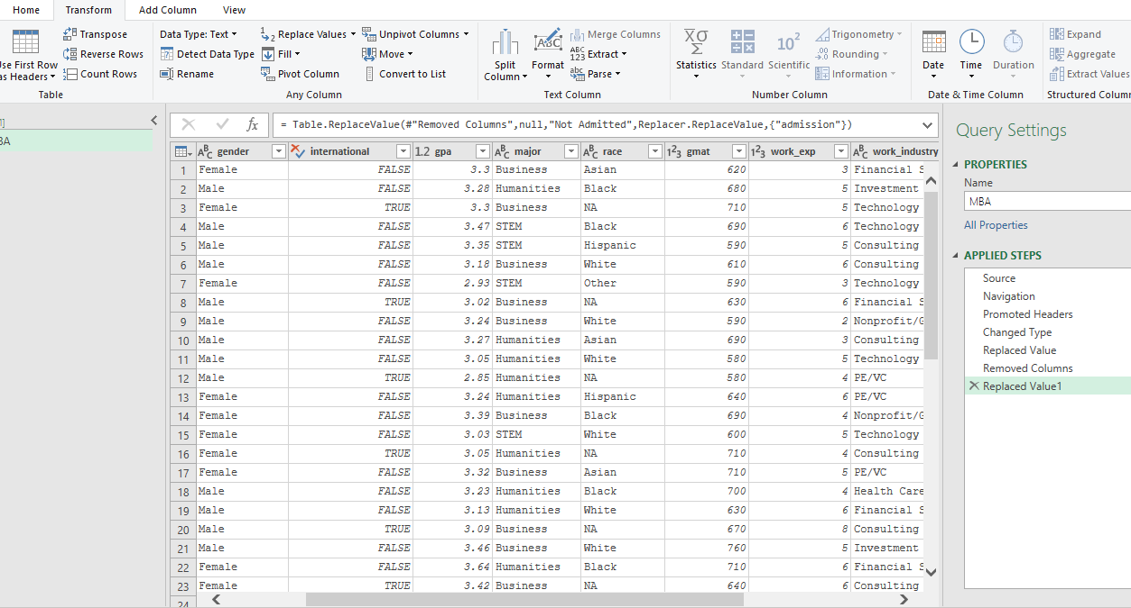
Data in Major column need to be corrected

Slide 18
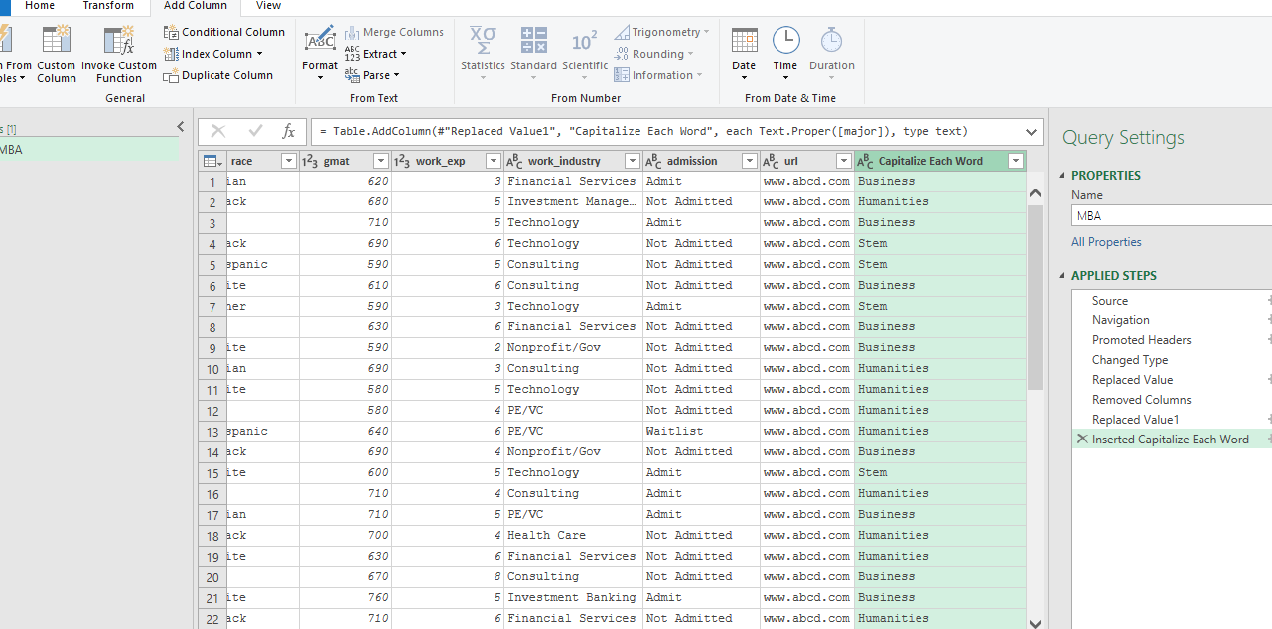
Caps

Slide 19
Deriving results through charts

Slide 20
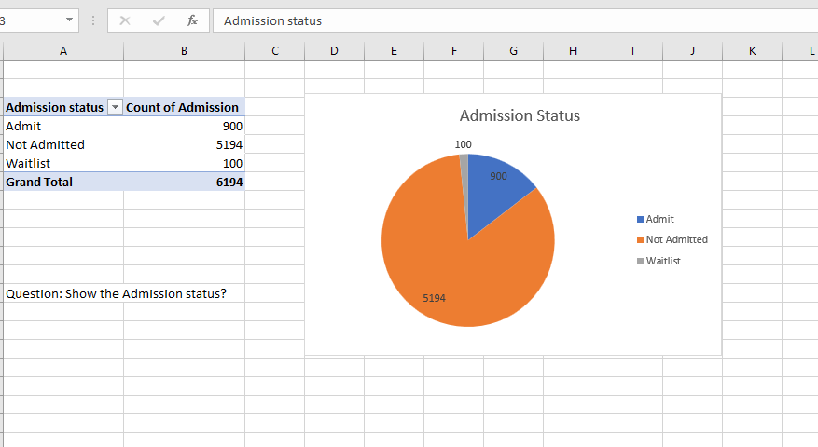
Admission Status

Slide 21
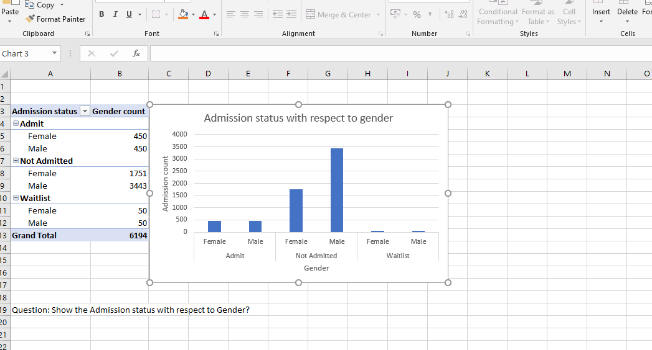
Admission status with respect to gender

Slide 22
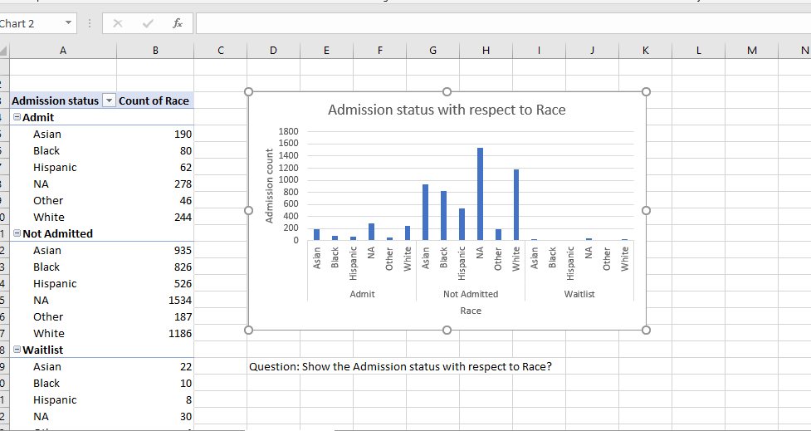
Admission status with respect to race

Slide 23
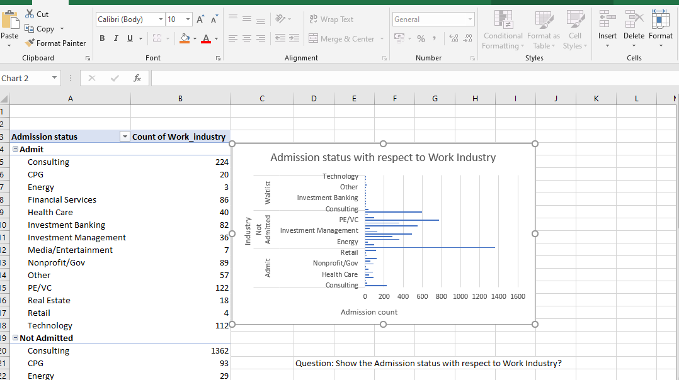
Admission status with respect to work industry

Slide 24
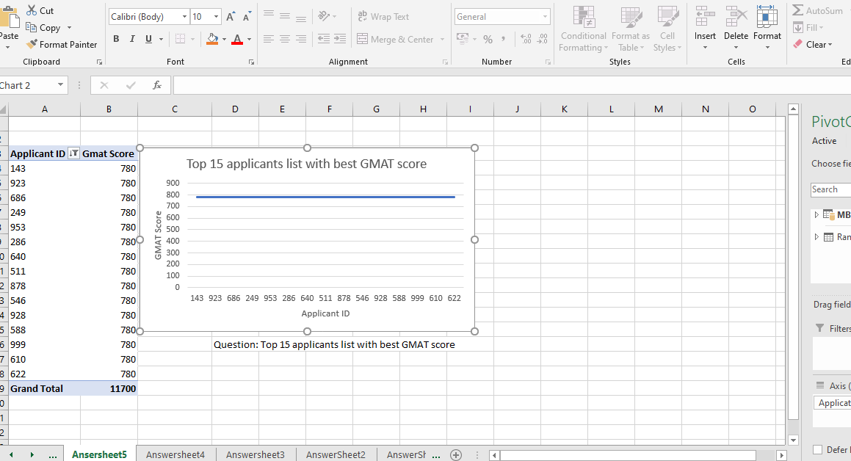
Top 10 candidates

Slide 25
Visualisation of the results

Slide 26
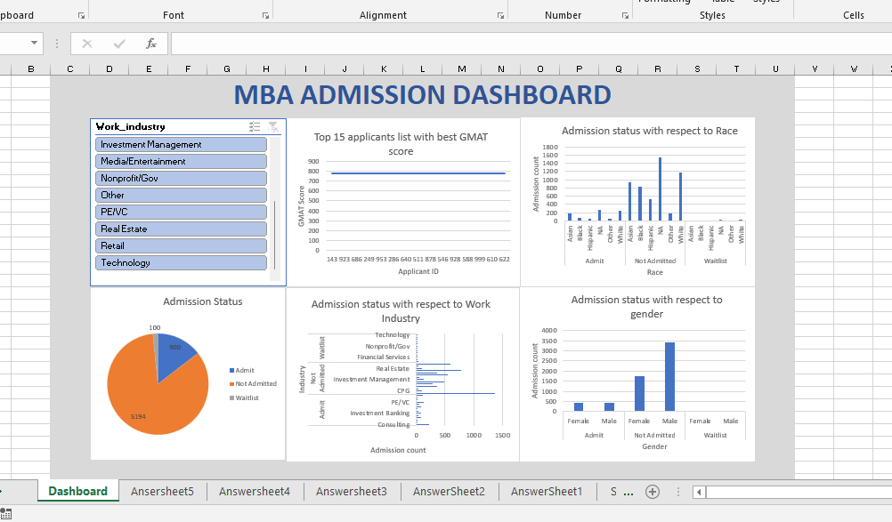
Final Dashboard on MBA admission

